Slide 1
Case Study
St. Colman’s Community College
2020 – 2022
School Coordinator:
Bridget O’ Connor
Creative Associate
Fiona Lawton

Slide 2
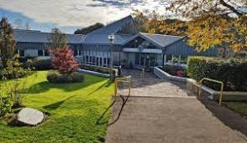
St. Colman’s Community College
St. Colman’s Community College is a mixed gender DEIS secondary school comprising over 1000 students and over 100 staff.
'We encourage and support our students to find expression for their talents and to develop their full potential.''
Rationale for joining the programme
We provide After School study, After School Club, Breakfast Club, Extra-curricular activities for example sports, drama, art and music, Junior Certificate Schools Programme, Green Schools and Ocean Hero club.
St. Colman’s aim is to enable creativity to underpin our approach to education by developing a cross- curricular approach to creative education in our school community.

Slide 3
Developing Partnerships
Zoom meeting online with creative associate, coordinator, student teachers and other staff to introduce the programme
Coordinator training online
Telephone meetings - informal
Building rapport
Information sharing
Creative conversations
Time and space to discuss and share ideas without a set agenda.
Open ended rather than prescriptive., more exploratory and uncertain.
The teaching process often necessitates a clear plan/structure. beginning and end point.
Need to share responsibility with other staff and creative associate to expand and develop these conversations.
Need to be open to hearing all perspectives.
Evolving creative process.

Slide 4
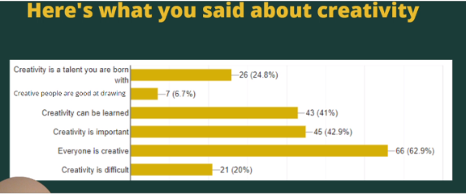
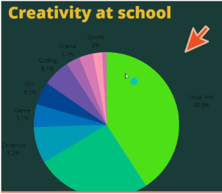
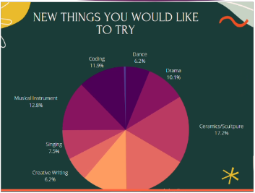
Children and Young People
Creative Committee established
Zoom meetings - Year 1 held after school
Online format - shy students mightn’t have been vocal but engaged via email/zoom - gave them time to think and reflect.
Creative forum created in google classroom to allow for maximum participation
Surveys on creativity completed online.
Year 2 - In person meetings - brainstorming ideas, continuing the creative conversations
Role of committee - Involved in planning, sharing ideas and organising the creative schools week, photography competition etc..
Reflections with students - learning about the creative process - from concept to execution/realisation.
Podcast: https://anchor.fm/fiona-lawton7/episodes/St--Colmans-Community-College-e1i8d2r

Slide 5
“He had us look deeply into the colours and shapes in the picture, something just clicked instantly!”
“Creativity is being able to do what you want!”
“Creativity is being able to do what you want and think of different things compared to other people, being different.”
“Creativity is making stuff by me for me”
“I like the way I can express myself”

Slide 6
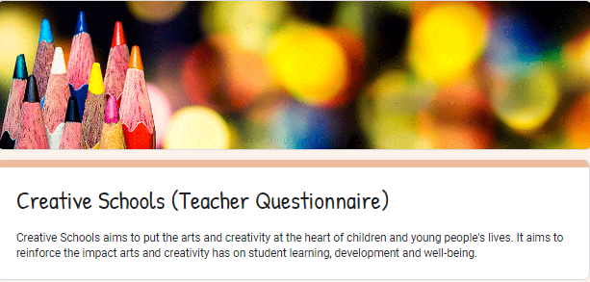
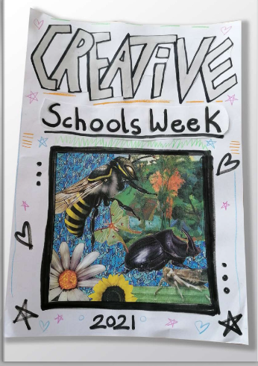
Understand Phase
Interim Reports
Identifying strengths and needs
Thematic planning for whole school paricipation
Creative Conversations
Surveys
Mobilising the school community
Developing vision and aims

Slide 7
Activities Year 1 - Creative Week
Art exhibitions in two assembly areas, Junior cycle and Senior cycle.
Creative writing workshops.
Debating club- link shared to teachers.
Poetry- reflection time
Photography Exhibition.
Parent and student submissions to digital flip book.
Link to Midleton Arts festival.
Journalism team - booklet. (Student Voice - Interviews with students)
Benefits of Creative Schools Week
Directly fed into the exploratory and understand phase.
Poetry student and affect on school community
Helped to Mobilise the school community after initial reticence.
Helped to raise the profile of the arts and creativity - having the structure allowed for buy in from management - e.g. Christmas Lights Project
https://anyflip.com/tvvwf/jeth/

Slide 8
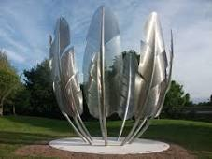
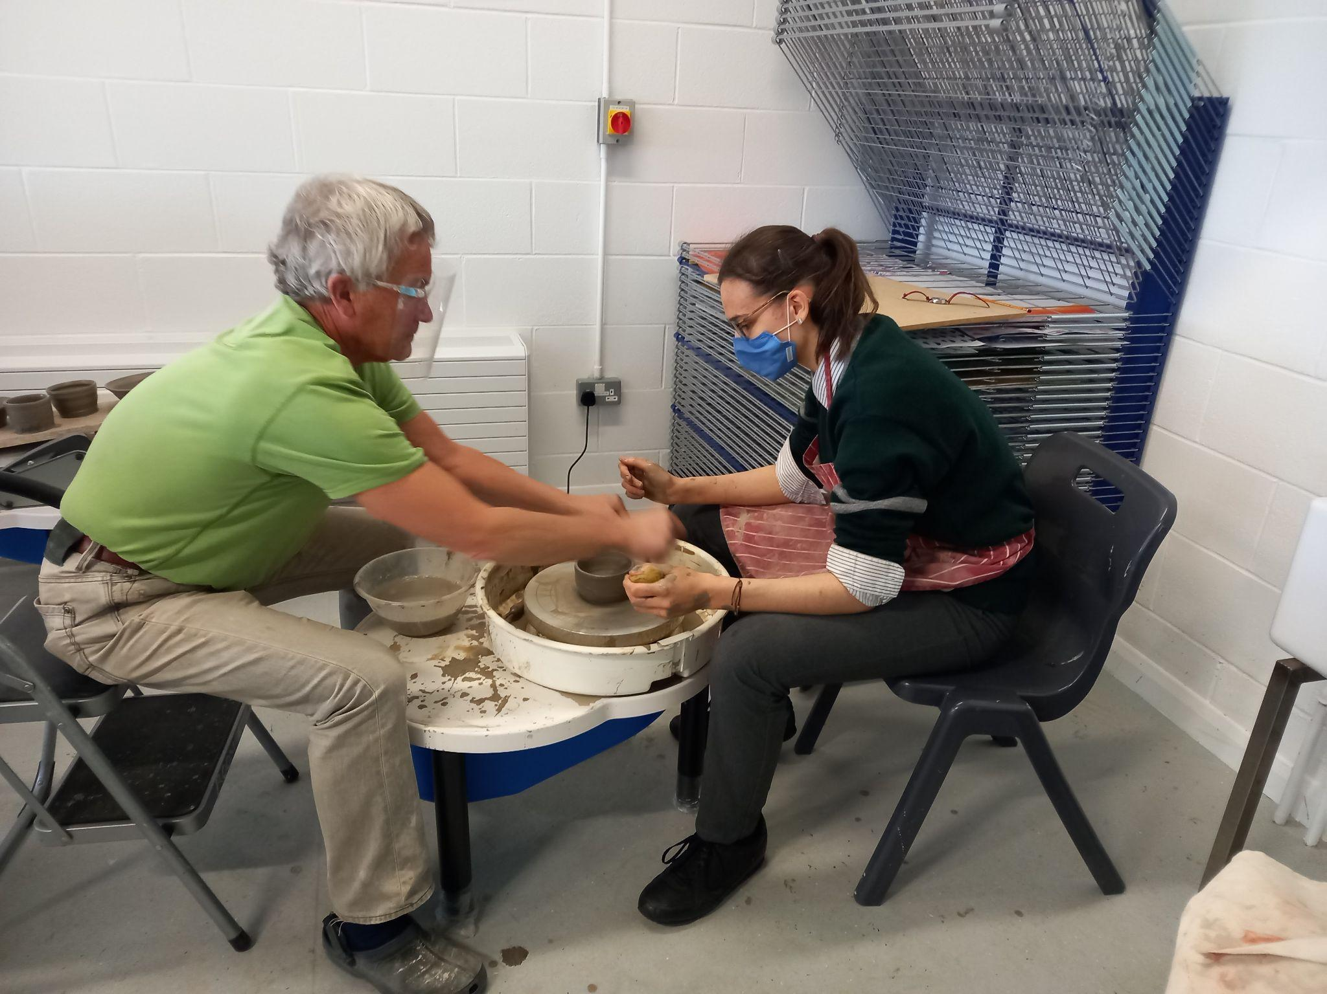
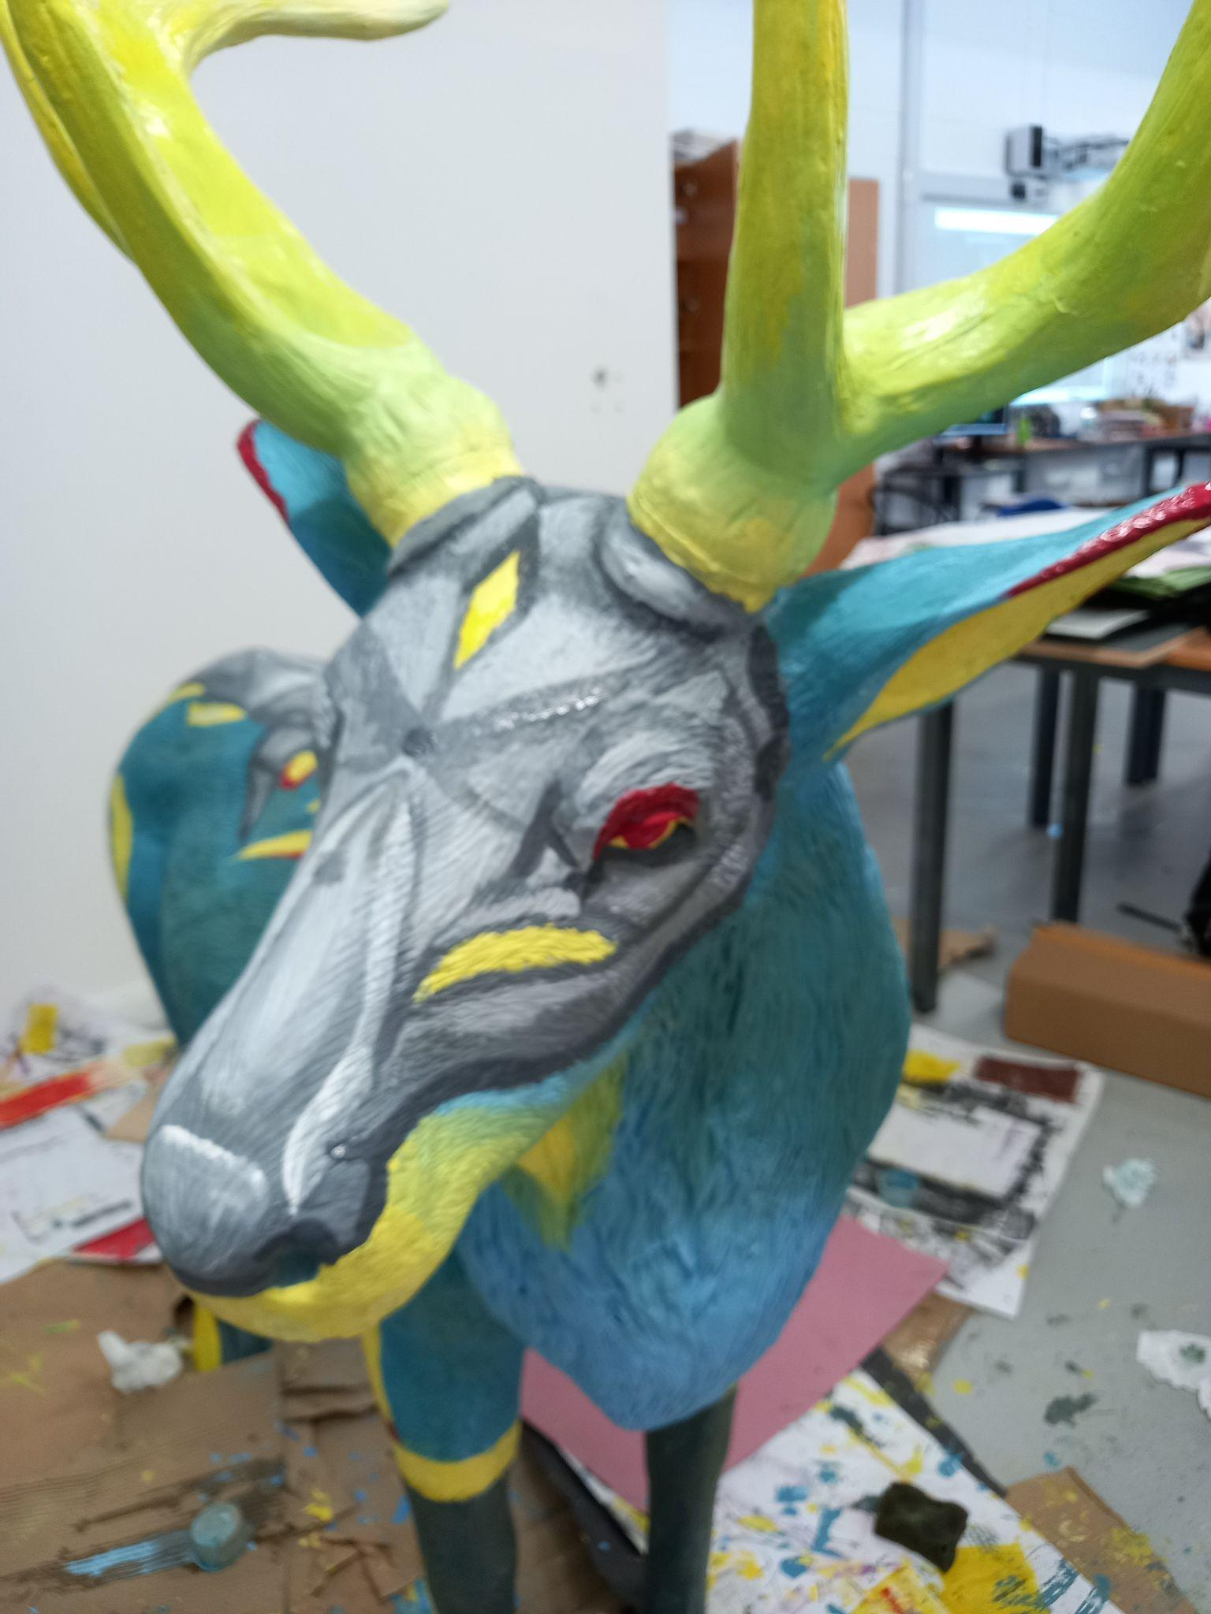
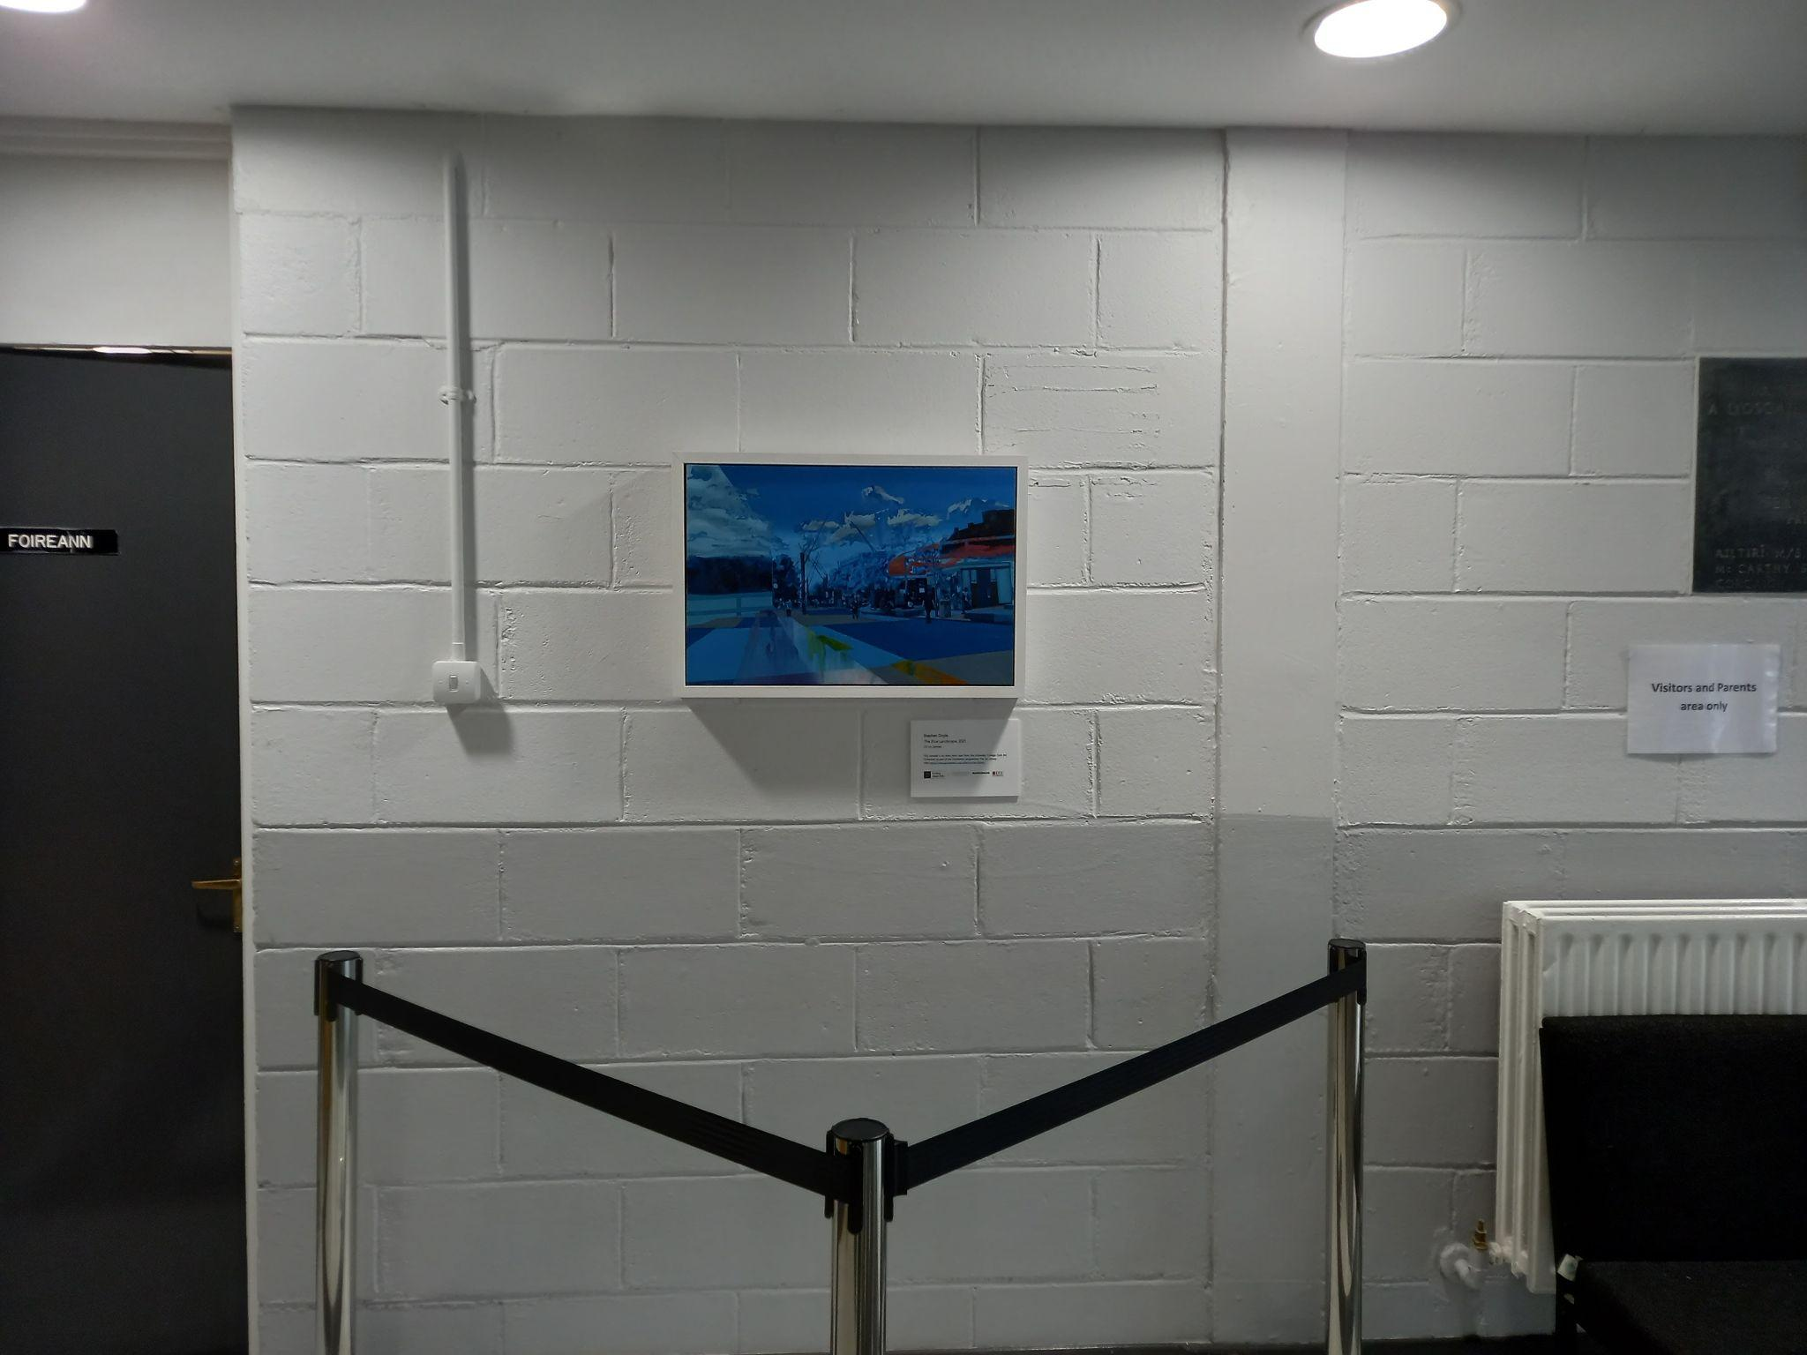
Developing relationships with artists and artistic organisations.
Ceramics, textile, and visual artists.
Alex Pentek
Kinsale Pottery (Adrien Wistreich)
Declan O’Meara Art
Art Library - Mobile Art Gallery Glucksman (Orla Dalby) - working with the school again, lots of resources integrating art with sphe etc.
Midleton Arts Festival
Christmas Lights Project
Ongoing opportunities/relationships (creative writing, engineering etc. emails)

Slide 9
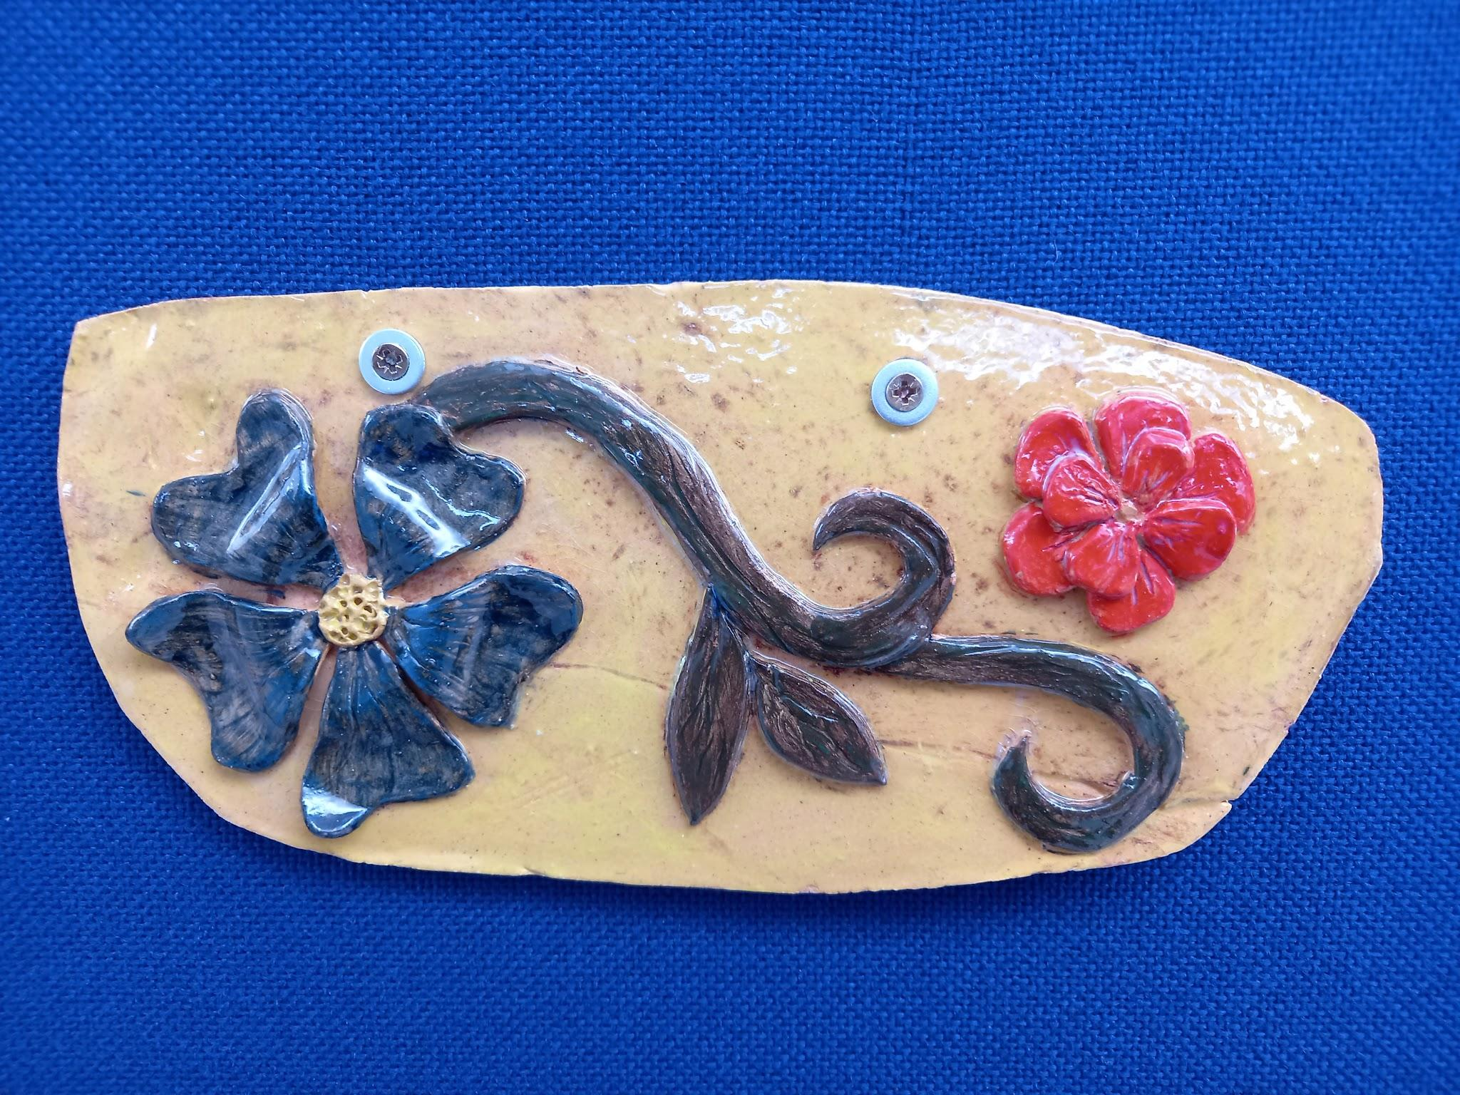
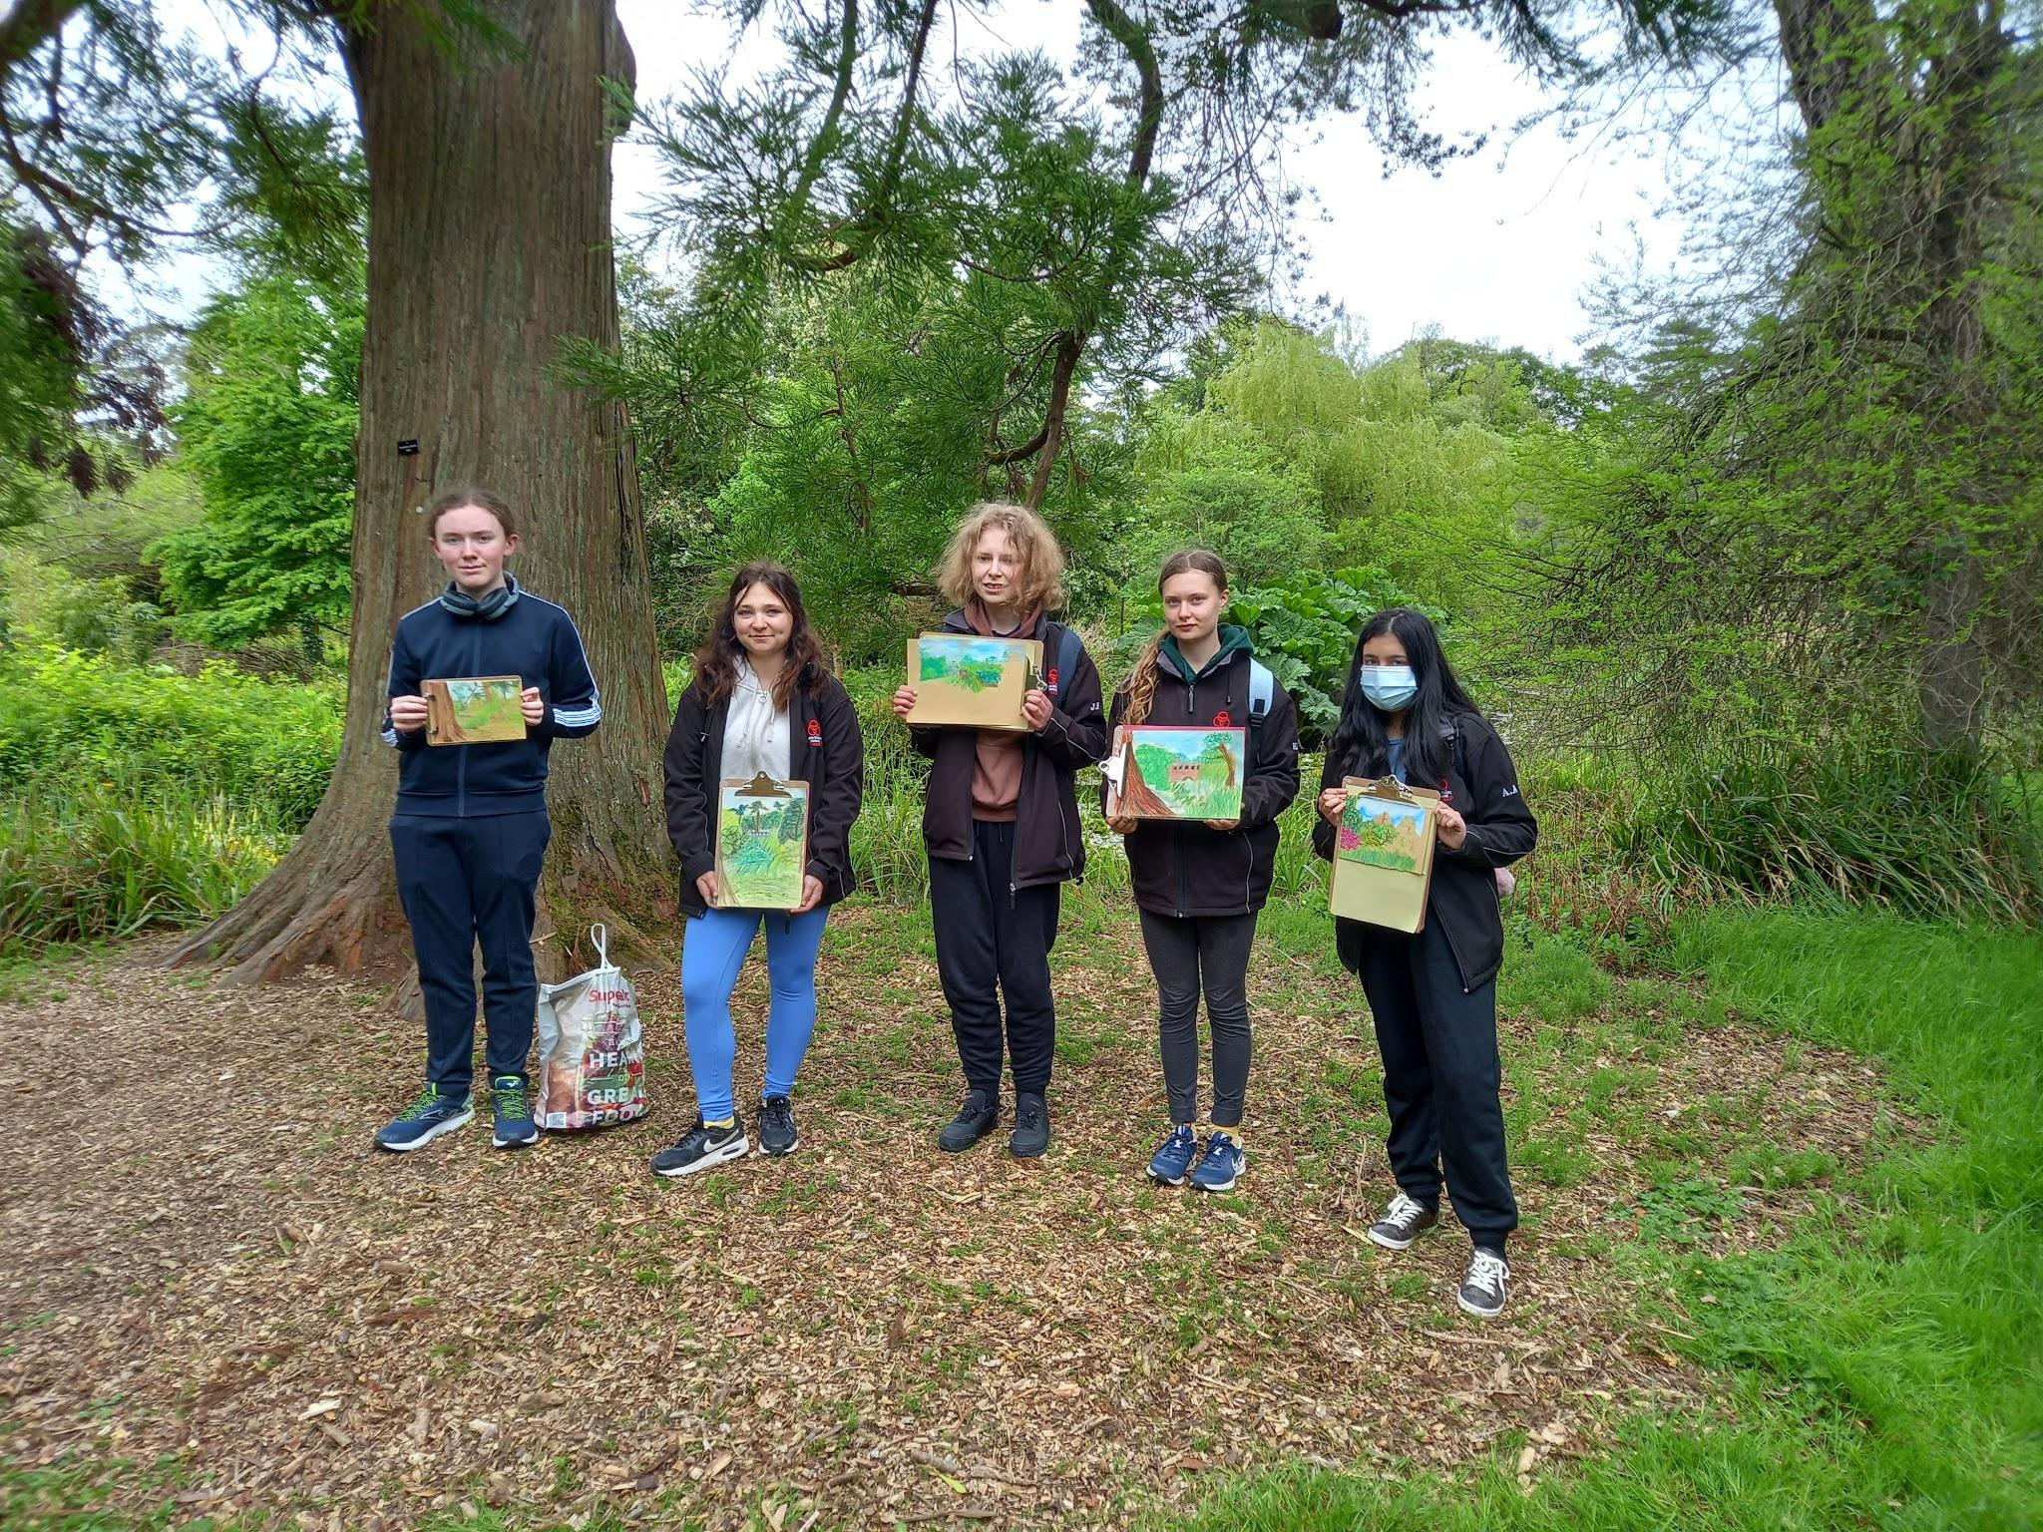
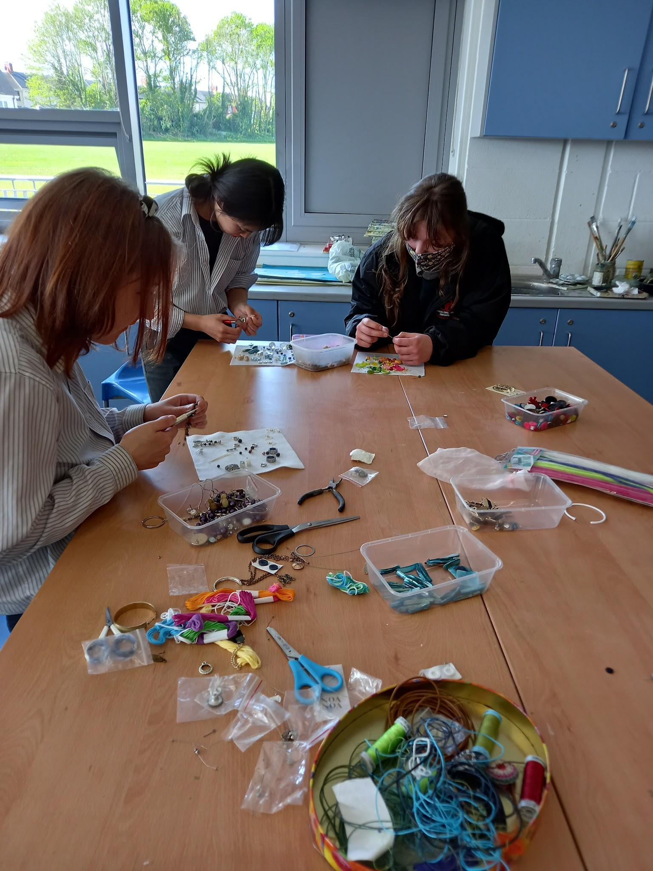
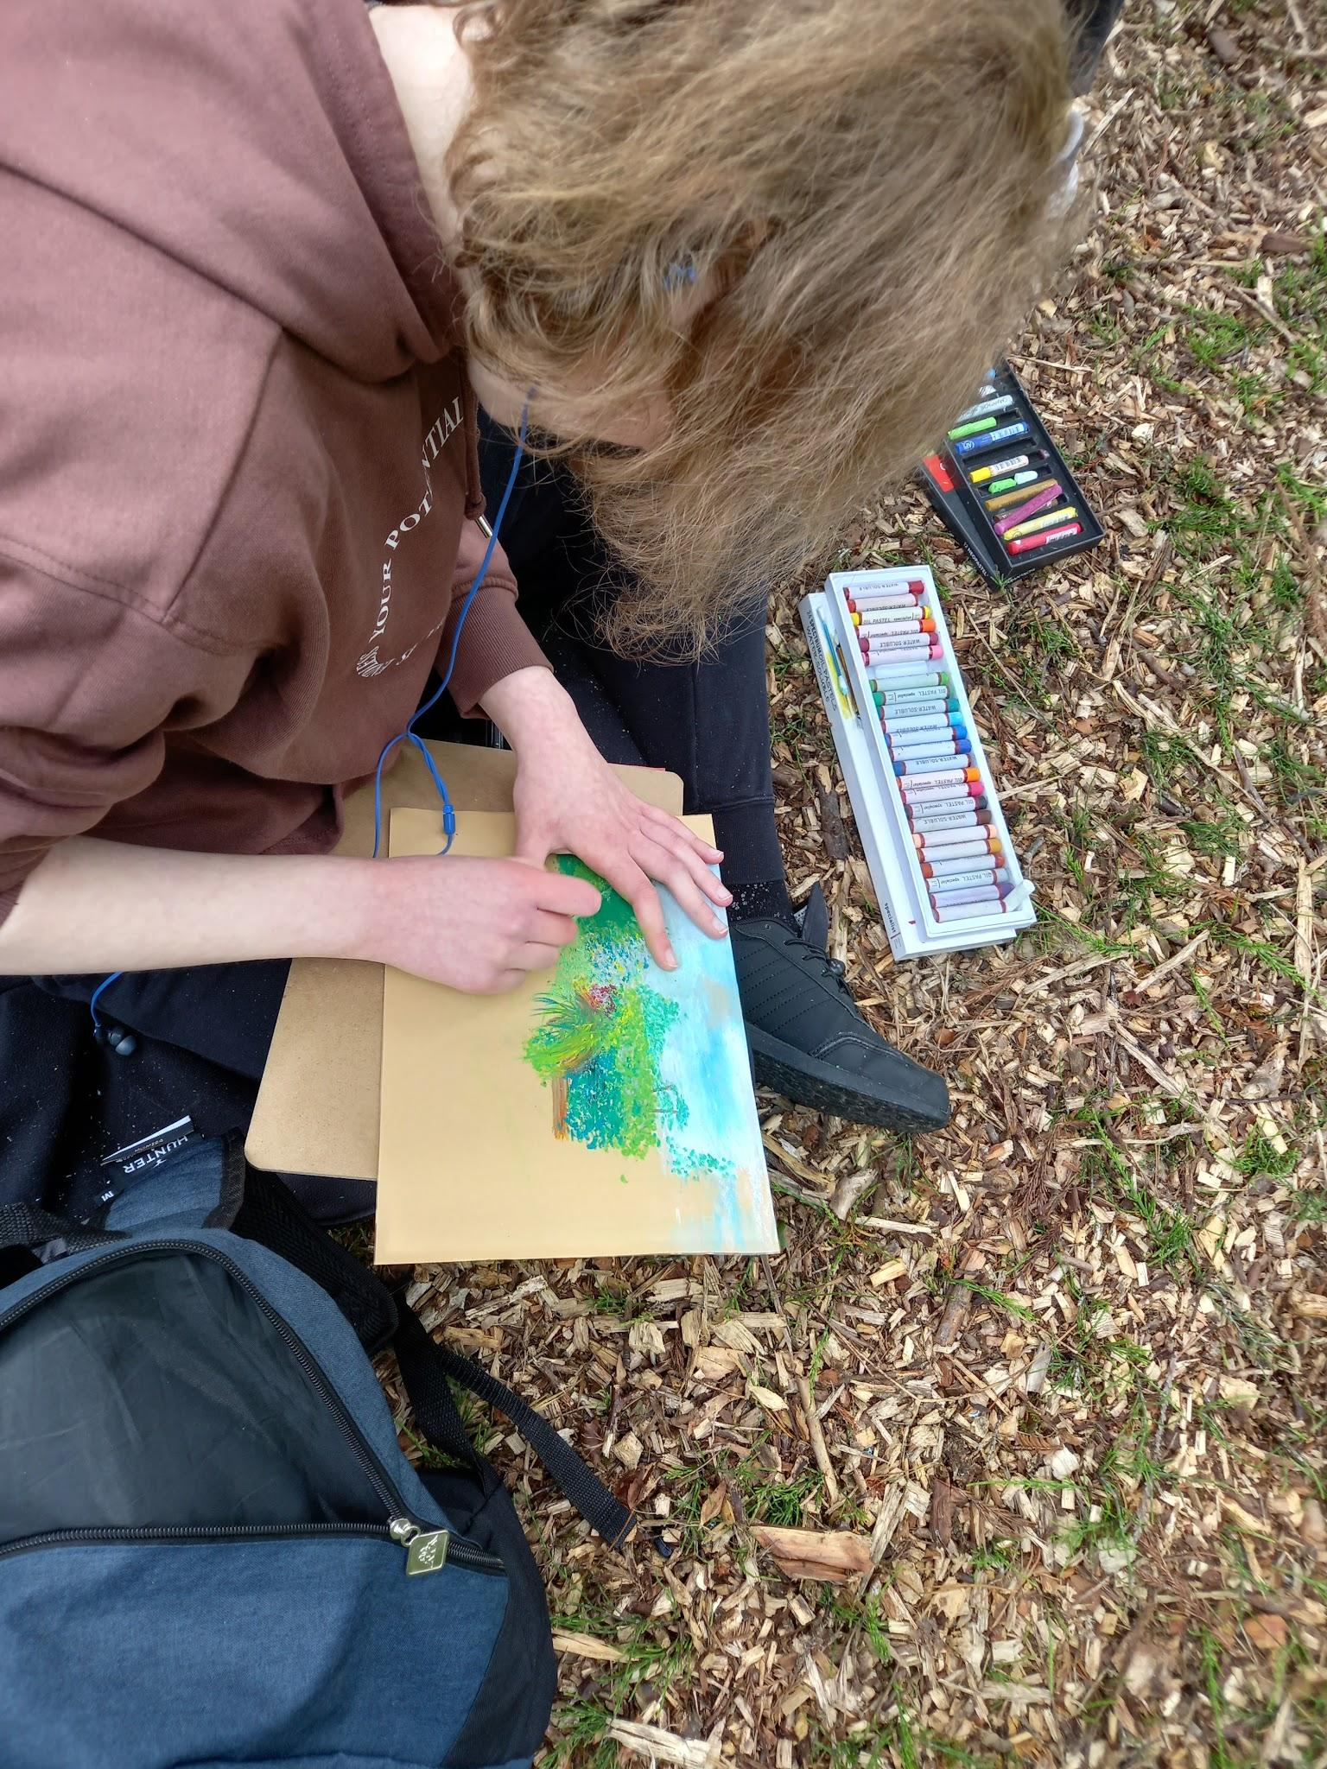
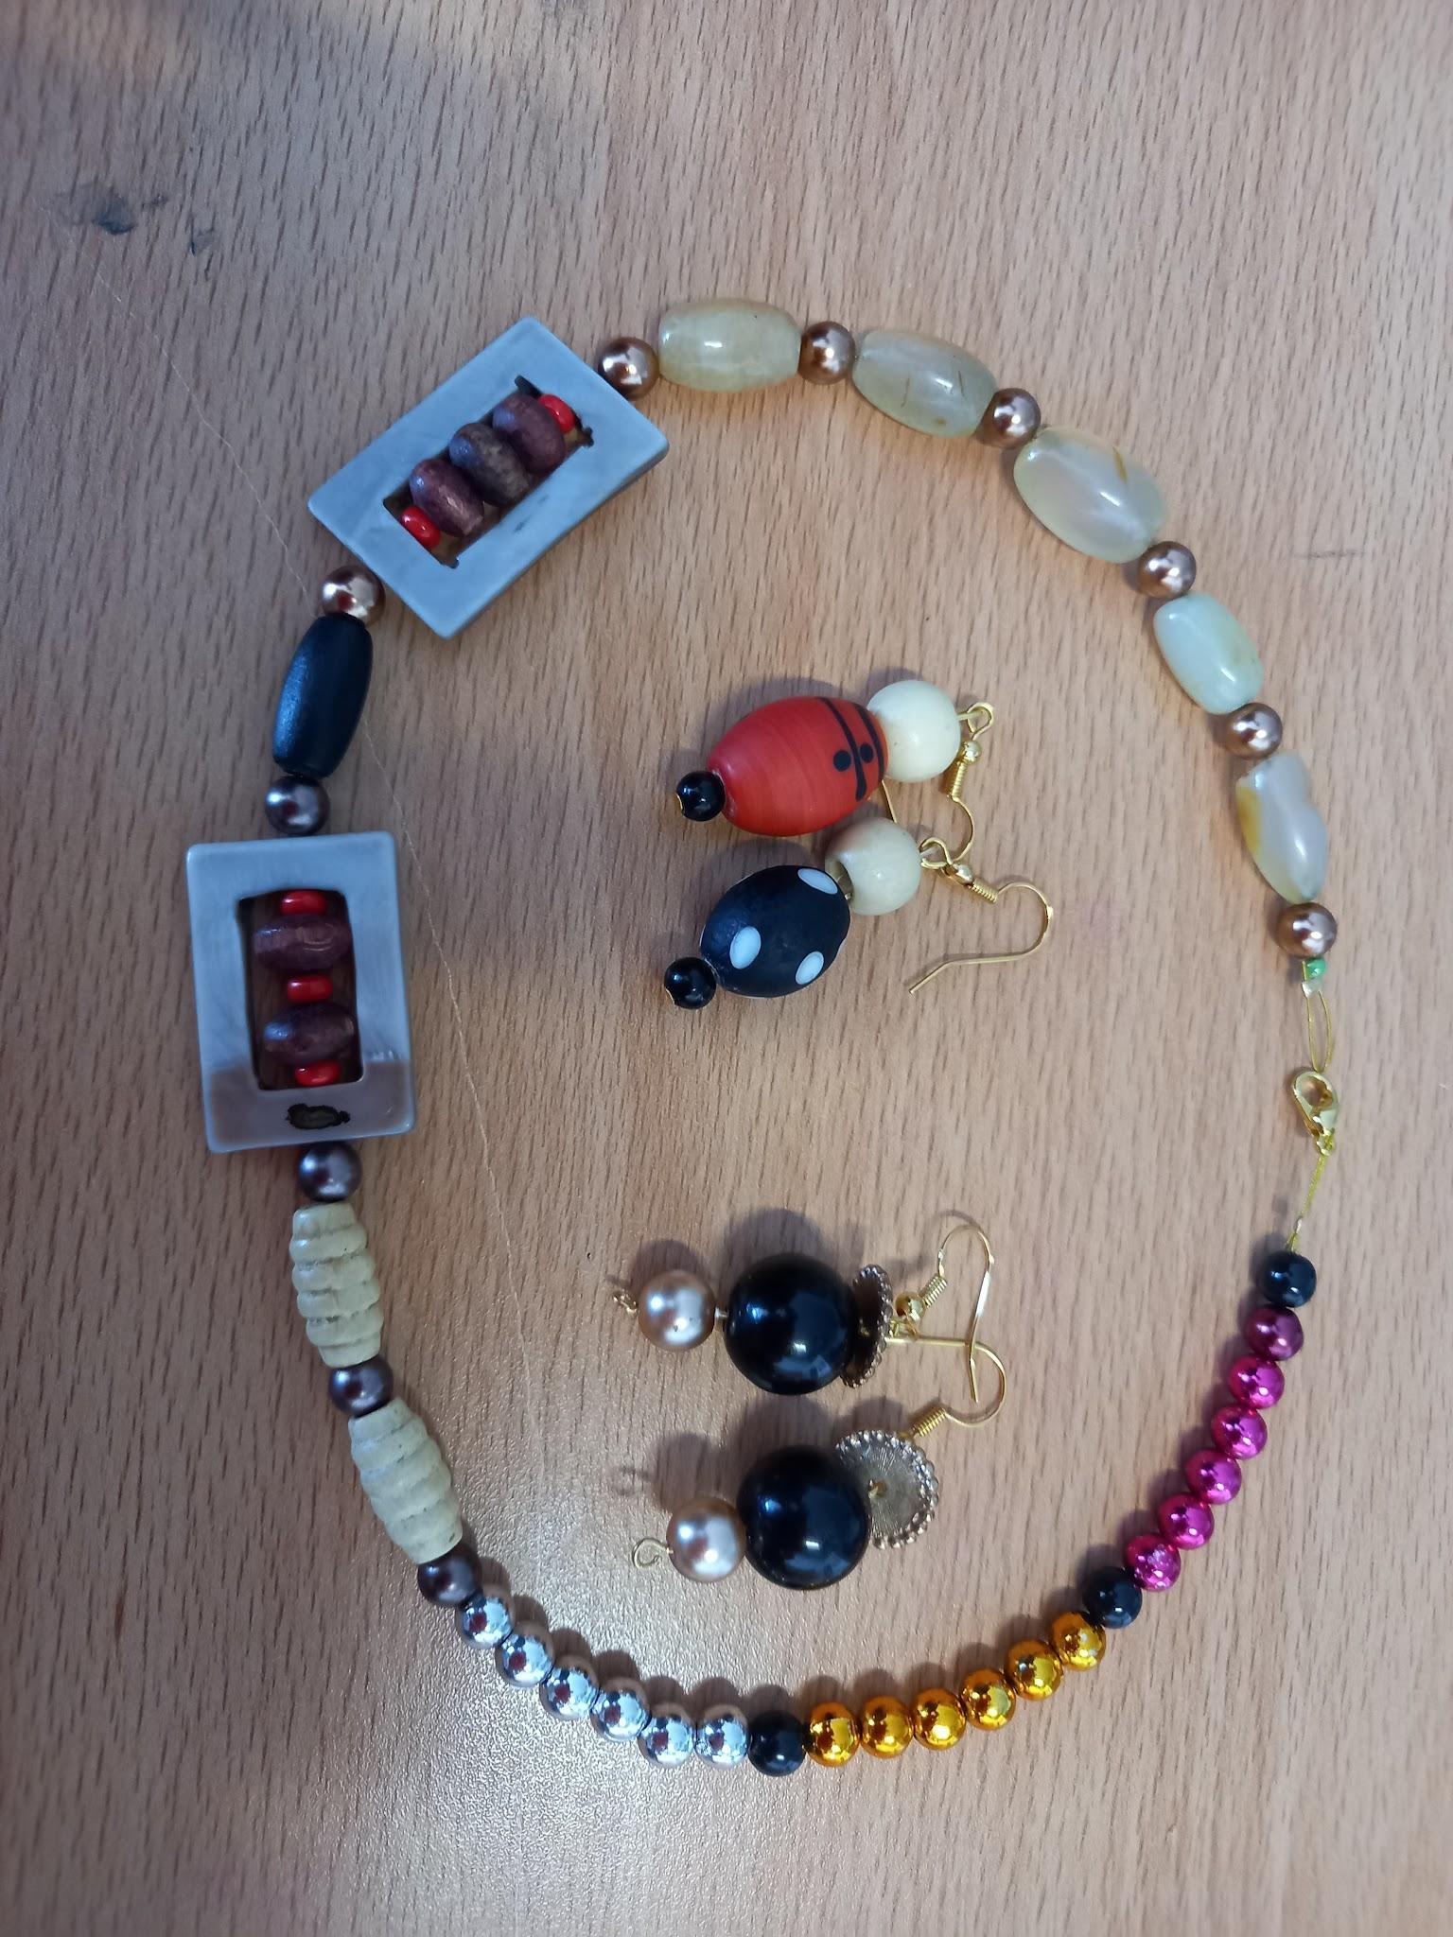
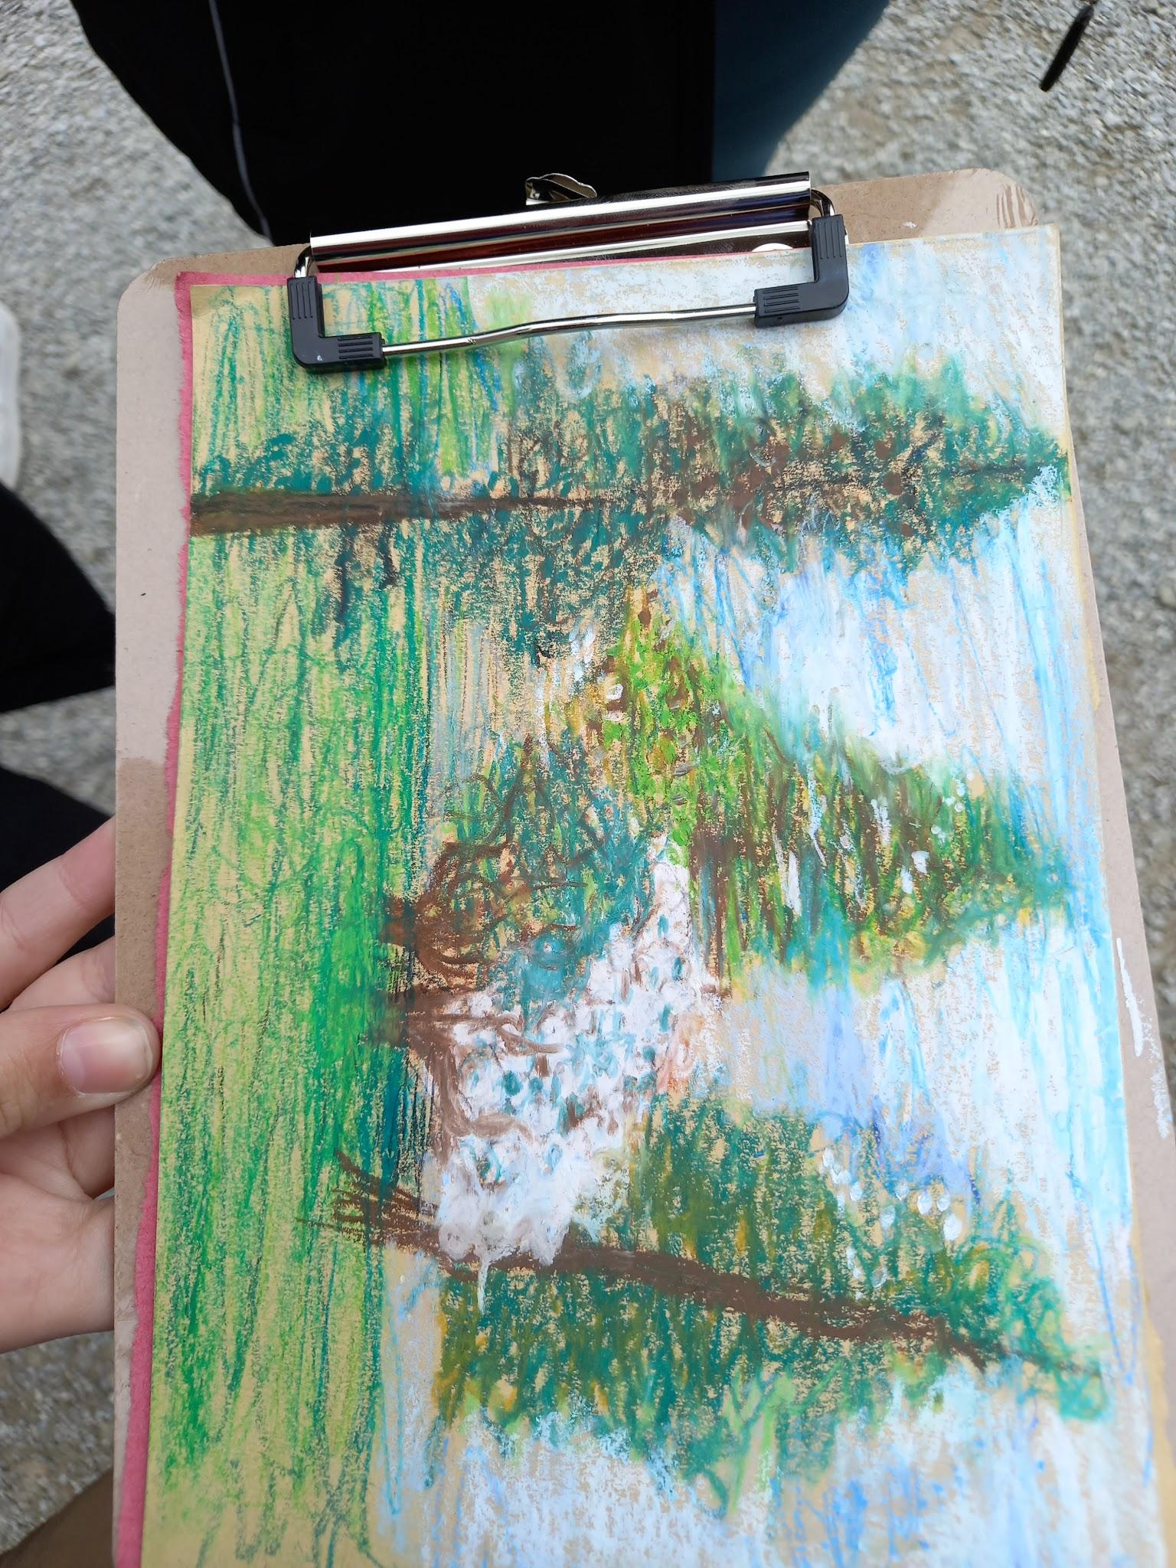
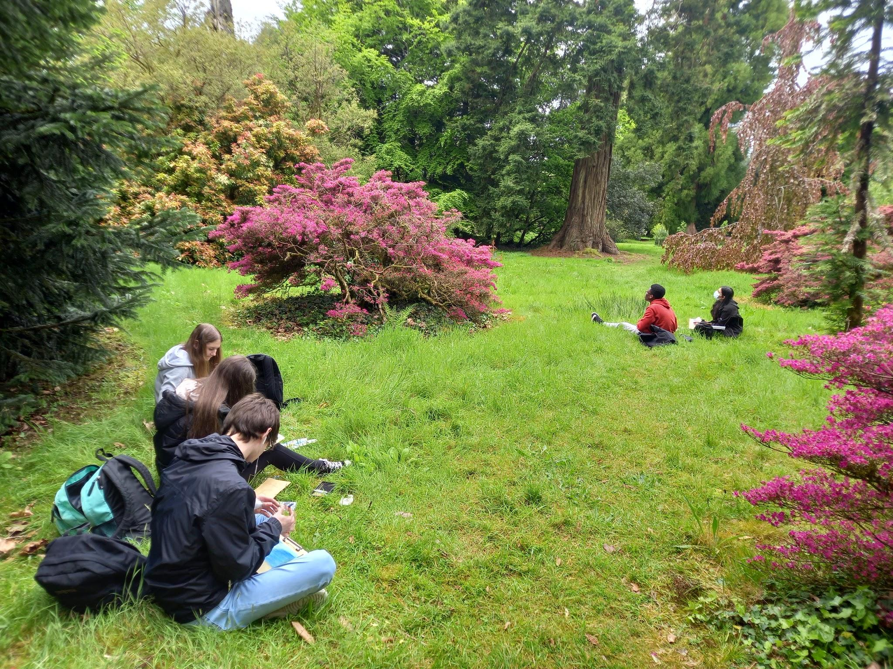
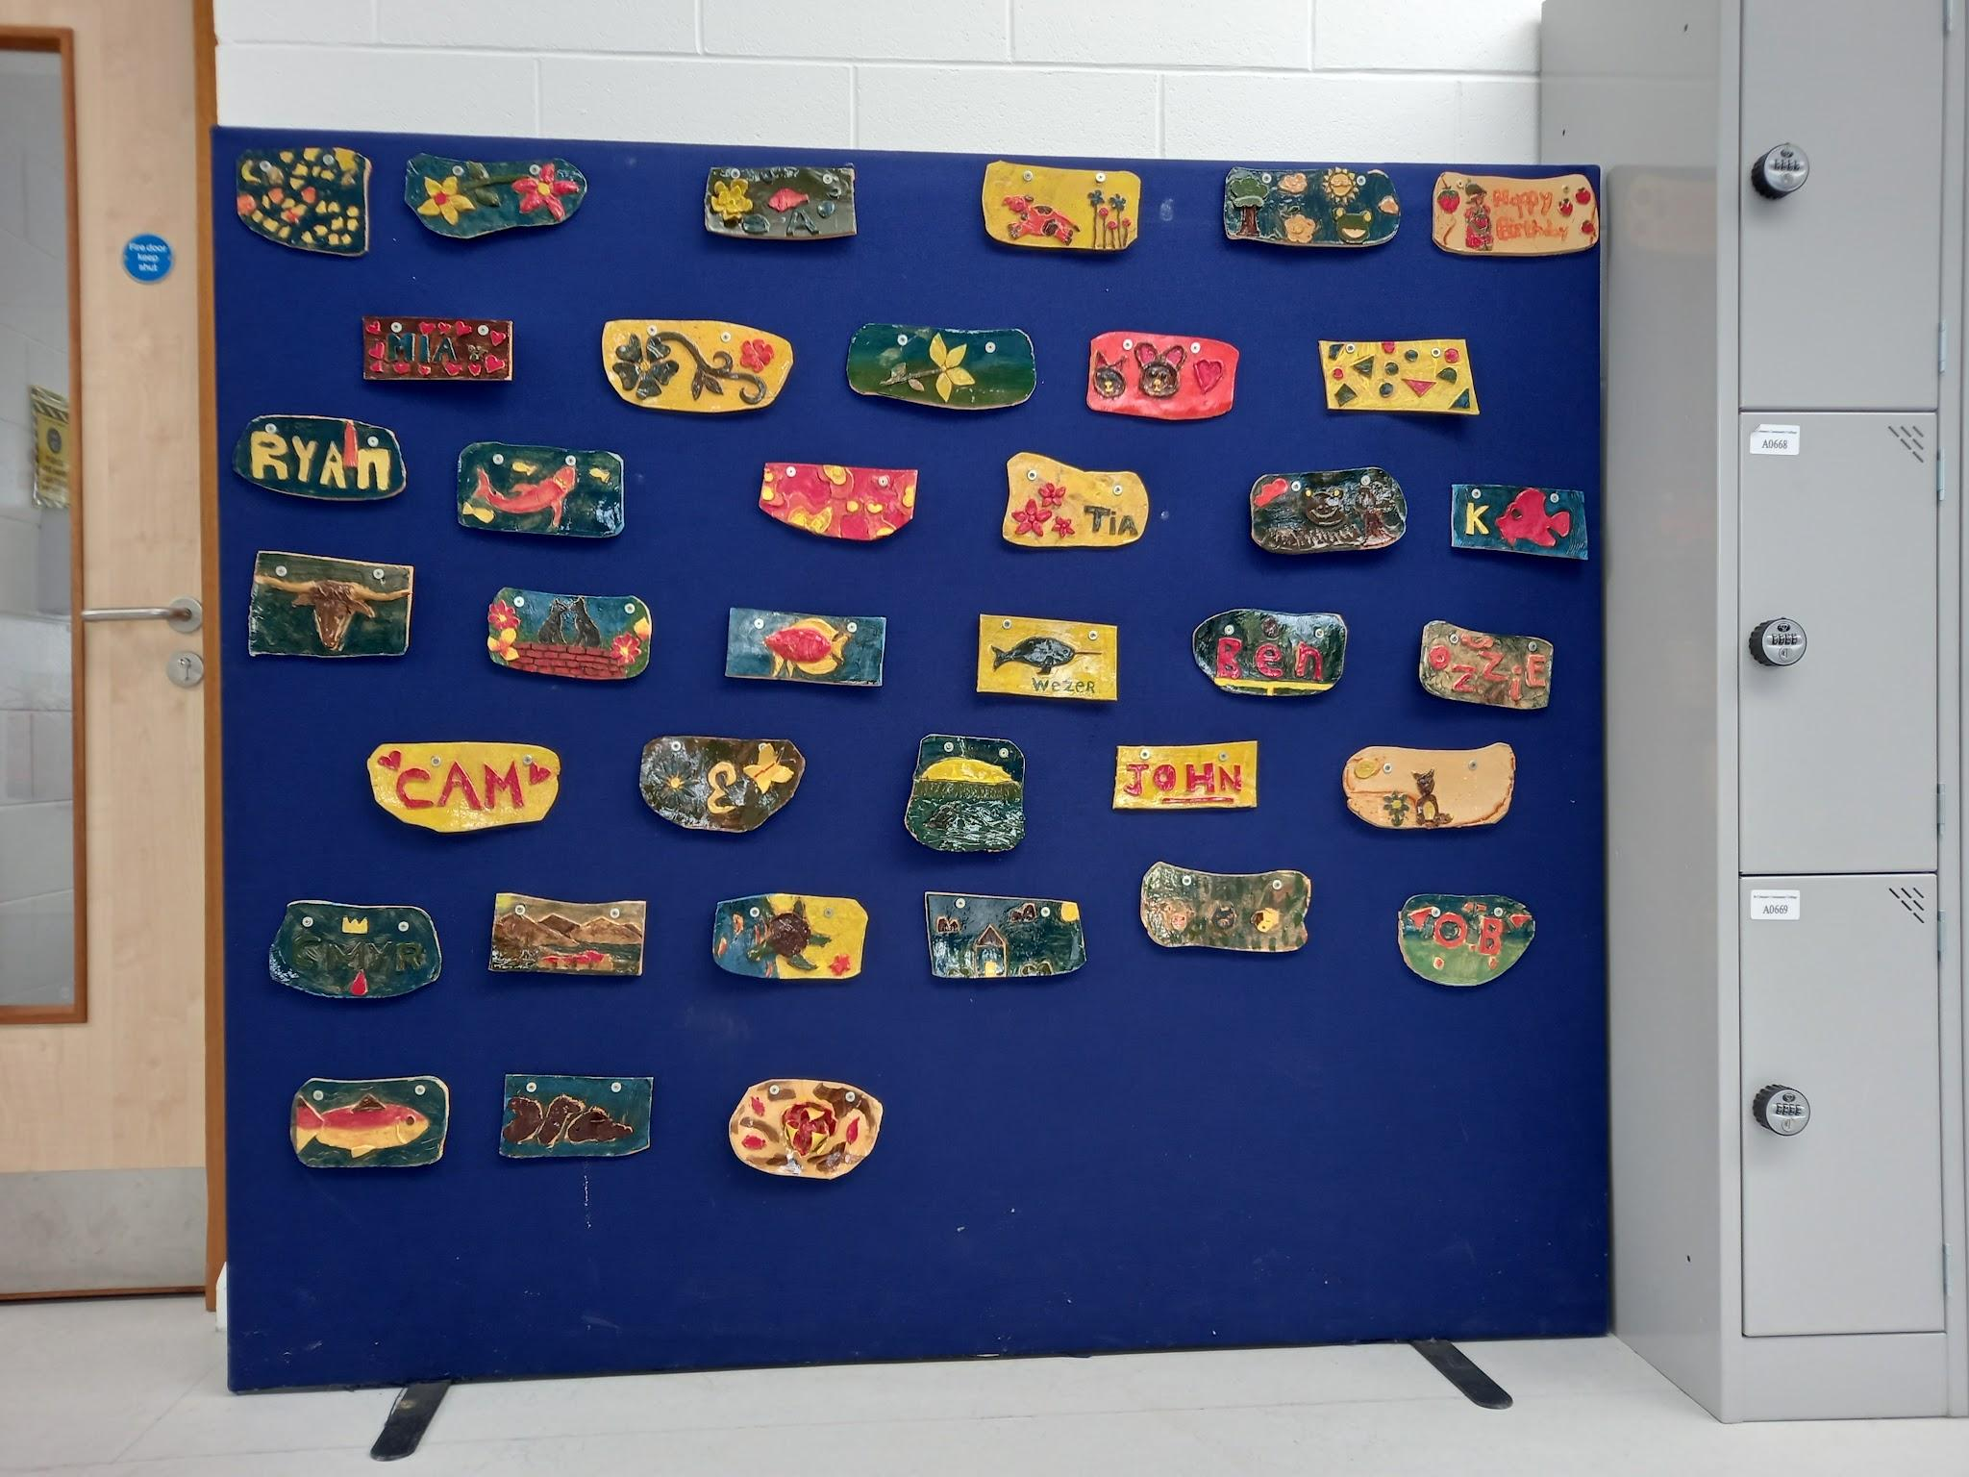
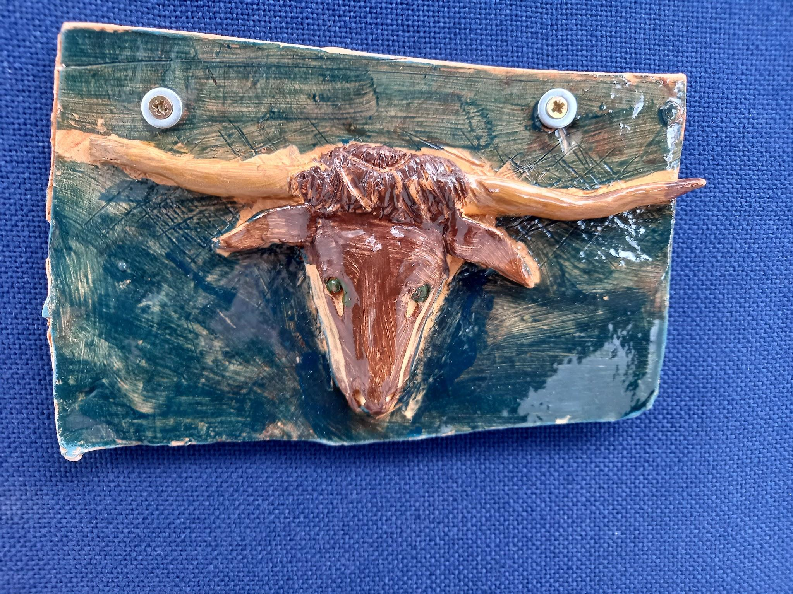
Activities Year 2 Workshops
Pottery
Applique
Oil pastel workshop linked to field trip
Oil pastel portrait
Jewellery
Creative schools week- exhibitions and competitions.

Slide 10
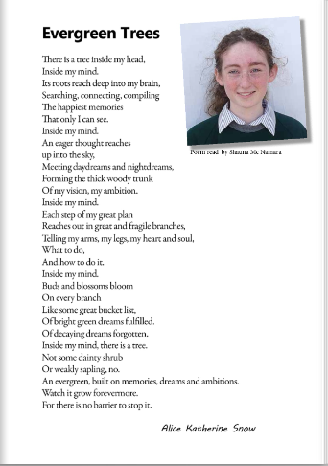
Highlights
Creative schools week
Poetry reading
Workshops
Challenges
Organisational challenge timetables, booking rooms, getting cover for classes etc. may have taken from embedding the creative process across all departments
Getting staff and management on board.
Next Steps
Continue Creative Schools week.
Applying for other grants
Teach meets to explore creative links within the curriculum.
Consolidate and develop relationships with artists
Integrate projects - e.g. Alex Pentek (Art and Engineering)

Slide 11
Case Study
St. Colman’s Community College
2020 – 2022
School Coordinator:
Bridget O’ Connor
Creative Associate
Fiona Lawton

